Slide 1




Slide 2
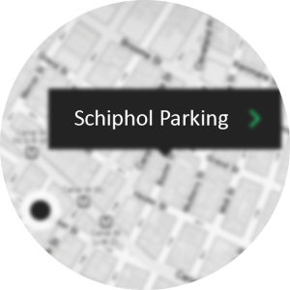
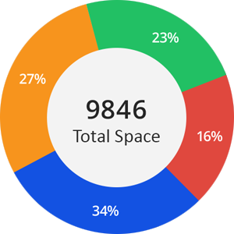

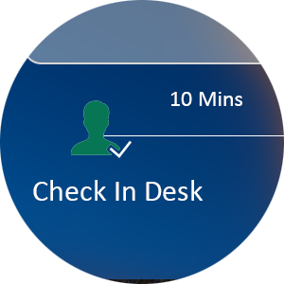
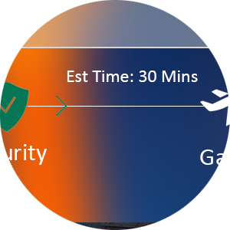
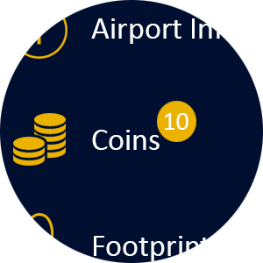


Google API will navigate you to available parking space in mobile.
Smart sensor will help us to find the free parking space.
The data collected from smart parking system help to forecast future business
Athena perfectly tells where to go by navigating and tracking for Check-in, Baggage drop off
and Security gate.
It will help to reduce waiting time and avoid queue on off peak
Parking
Real Time
Gamification
Rewarding system through which passenger can collect coins and later reclaim in stores.
Location based AD
Through which agency can advertise directly passenger right through our mobile app in turn
it can generate more revenue.
Physically Challenged
Tools they provide for disabled are simply sound in their means.

